Slide 1
Lecture 6a – Review of ROC curves and AUC
Breitzman 10/9/2018

Slide 2
Intro
We saw ROC curves in DM 1, but they come up in the SMOTE paper I want to talk about, so we’ll do a quick review

Slide 3
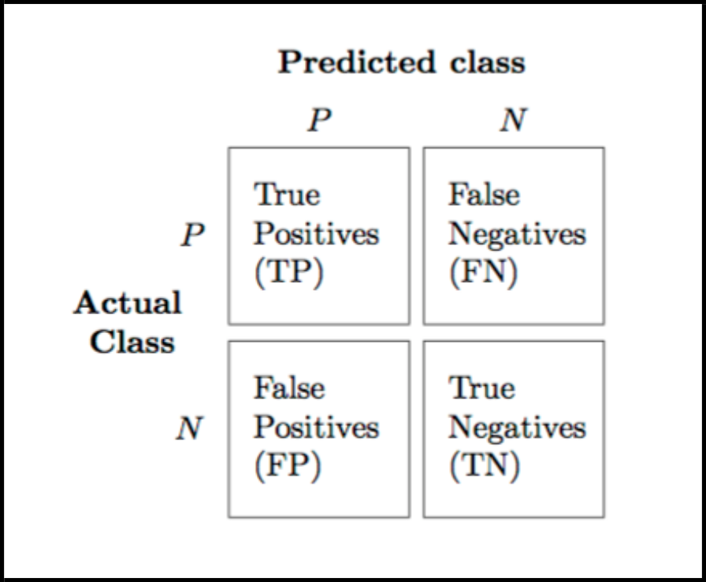
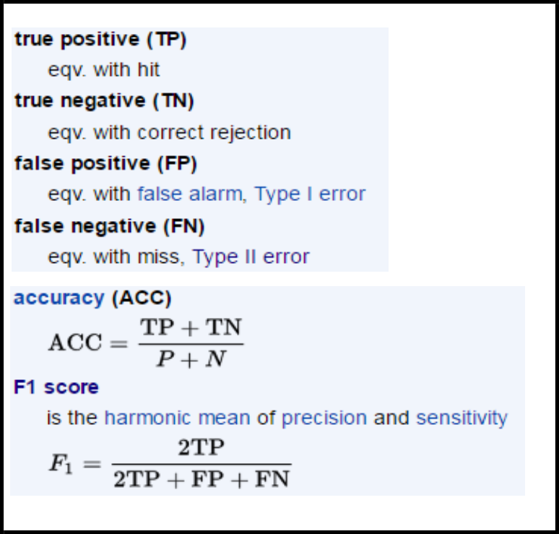
Recall Confusion Matrix
There’s a built in one, but also Easily built in R with count(testingData,c(“actual",“prediction"))
This gives us TP, FP, TN, FN which are then used in the calculations on the right

Slide 4
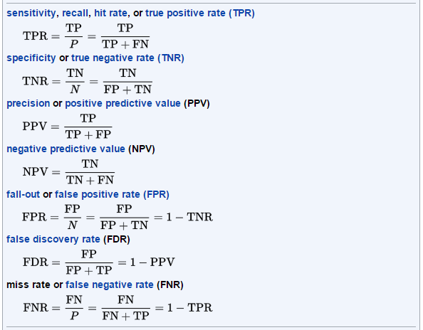
Other Metrics Derived From Confusion Matrix

Slide 5
ROC and AUC
You would think that would be enough indicators
A lot of papers use another one called ROC and it’s cousin AUC
ROC Curve stands for “Receiver Operating Characteristic Curve” which is a meaningless name at this point, but has it’s origins from world war II when it was developed to assess how well we were predicting enemy planes via radar following the attack on Pearl Harbor
It is used to assess binary classifiers (yes she has diabetes, no she doesn’t) at various thresholds (remember how in NN’s we usually let the threshold be 0.5. We don’t need to)
The curve is created by plotting the (TPR) on previous page against the (FPR) at various threshold settings.
Some ROC curves plot TPR v TNR (sensitivity v specificity)

Slide 6
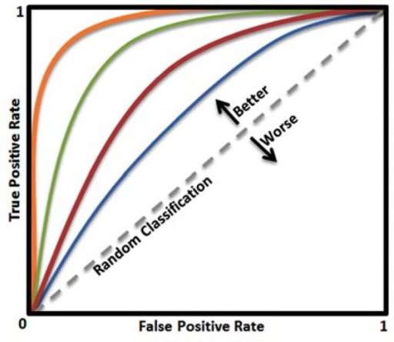
Another Way to Think of This
Start at the origin. Move north every time you see a TP and east every time you see an FP.
You would expect a random classifier to be a step function that moves roughly along the 45 degree line.
If our classifier returns a real number between 0 and 1 we can adjust the threshold to move the curve out towards the north west corner
A good classifier should hit many TP for every FP

Slide 7
Why do we care?
If you have uneven data sets, things like mean square error and F1 score might not capture what we need
For example suppose we are trying to predict the probability of someone bringing a bomb onto a plane
Our training data has 20 million 0’s representing passengers without bombs and two 1’s representing passengers with bombs
We can build a classifier that always says the passenger has no bomb and we will have 99.99999% accuracy, but it’s not particularly useful for modeling who might bring a bomb on a plane
If we add a cost function so that FN has a huge weight (say FN=FN*1000, FP=FP*10, TP=TP*2, and TN=TN) then an ROC curve can be quite useful in comparing classifiers and choosing thresholds

Slide 8
Go To
breastCancerROC.docx
Note AUC = Area Under ROC Curve

